Slide 1



How online Scam becomes a criminal enterprise
For the love of money is the root of all evil - “1 Timothy 6:10”
Hieu Minh Ngo - NCSC Viet Nam (ncsc.gov.vn) - Co-founder: ChongLuaDao.vn

Slide 2


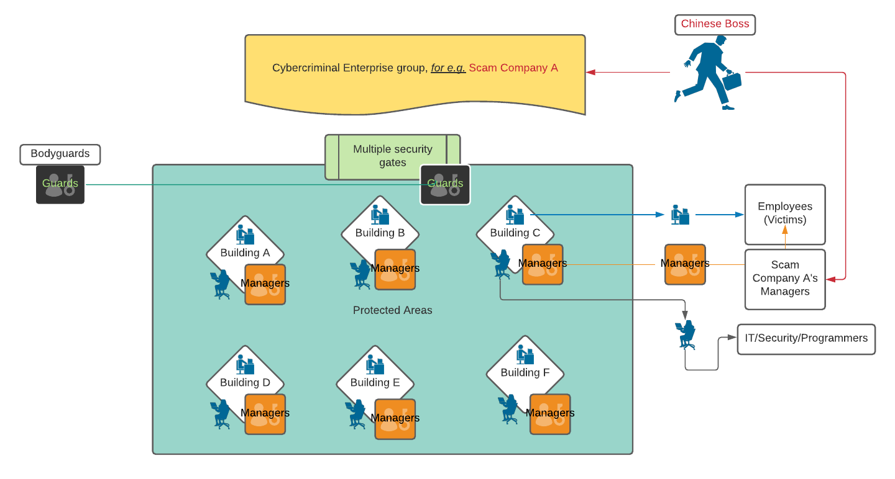

Criminal Enterprise Structure
Notes:
Most forms of frauds are a/ high-profit multi-level investment platforms - b/ disguised as Vietnamese famous brands such as Tiki, Shopee, Lazada,...to misleading people to get easy jobs - c/ chat sex app - d/ scam online gambling websites - e/ misleading loan app/website - f/ impersonate police officers (vishing, smishing) More information: https://www.interpol.int/en/News-and-Events/News/2020/More-than-20-000-arrests-in-year-long-global-crackdown-on-phone-and-Internet-scams https://docs.google.com/document/d/16pdrHgxUVesVx5B_LNXQj3SMRhzzWjrQXnXjSINf2sI/edit?usp=sharing

Slide 3

Let’s find out

Slide 4


TABLE OF CONTENTS “Crime is getting easier”
Source code
Malicious developers
Slave workers
Free and paid “scam” source code anywhere
Getting good salary, money blind eyes
Being lured to work for scam centers as a slave
Data sources
Human traffickers
Easy to scale
IDs, PII, bank account, social media profiles - easily to get or to buy
Get paid to trick slave workers
Cloud computing, cheap domains, easy to clone….
Each of these groups, one way or another helps to build a great economy for “Scam Centers”

Slide 5

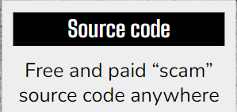
Source code

Slide 6
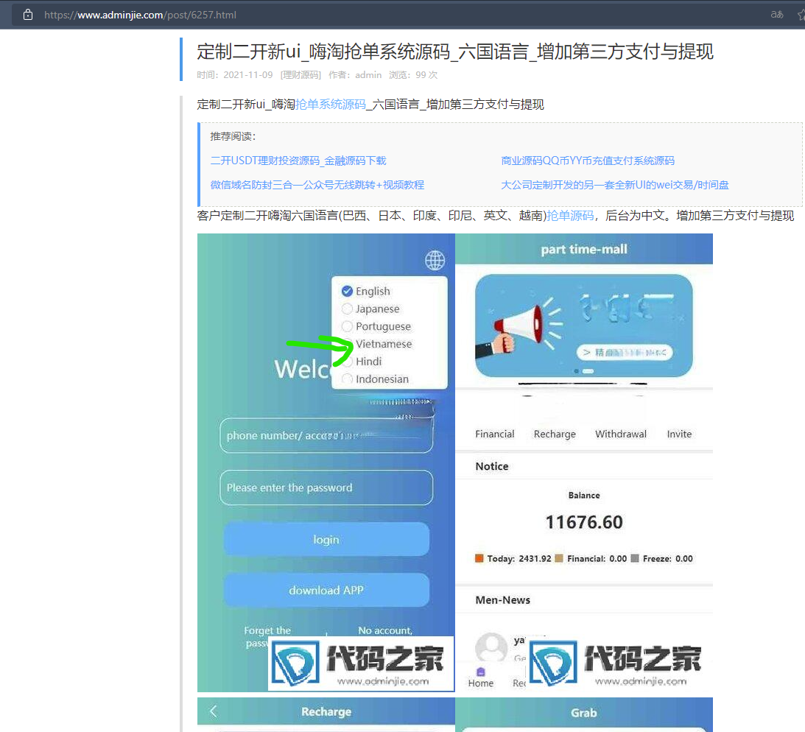
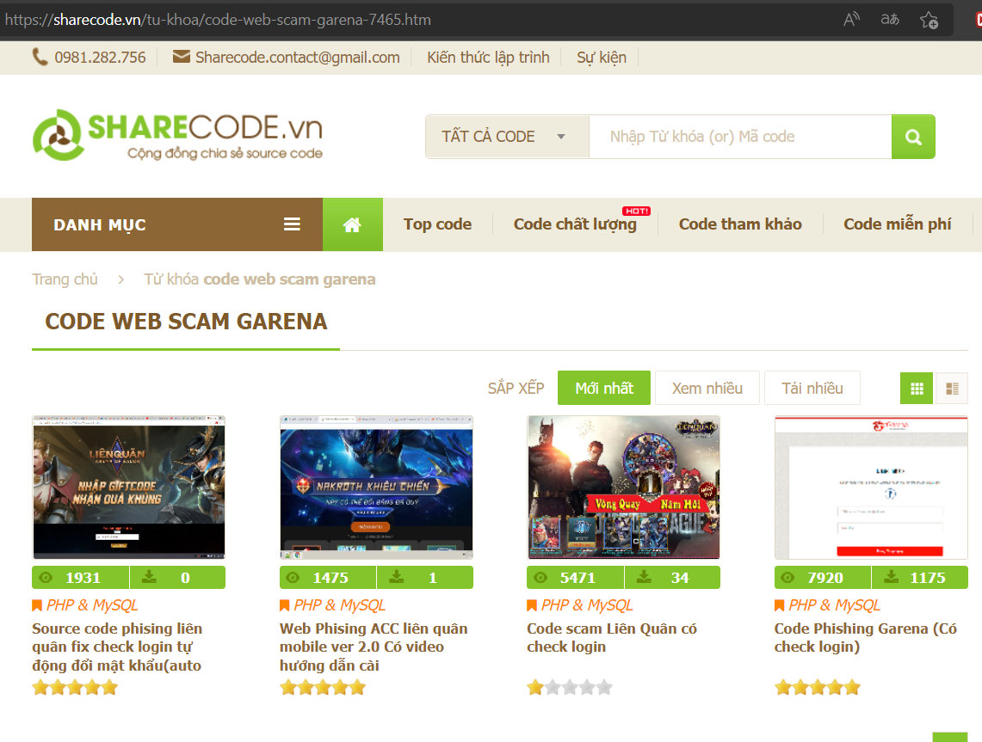
Source code Free and paid “scam” source code anywhere

Slide 7
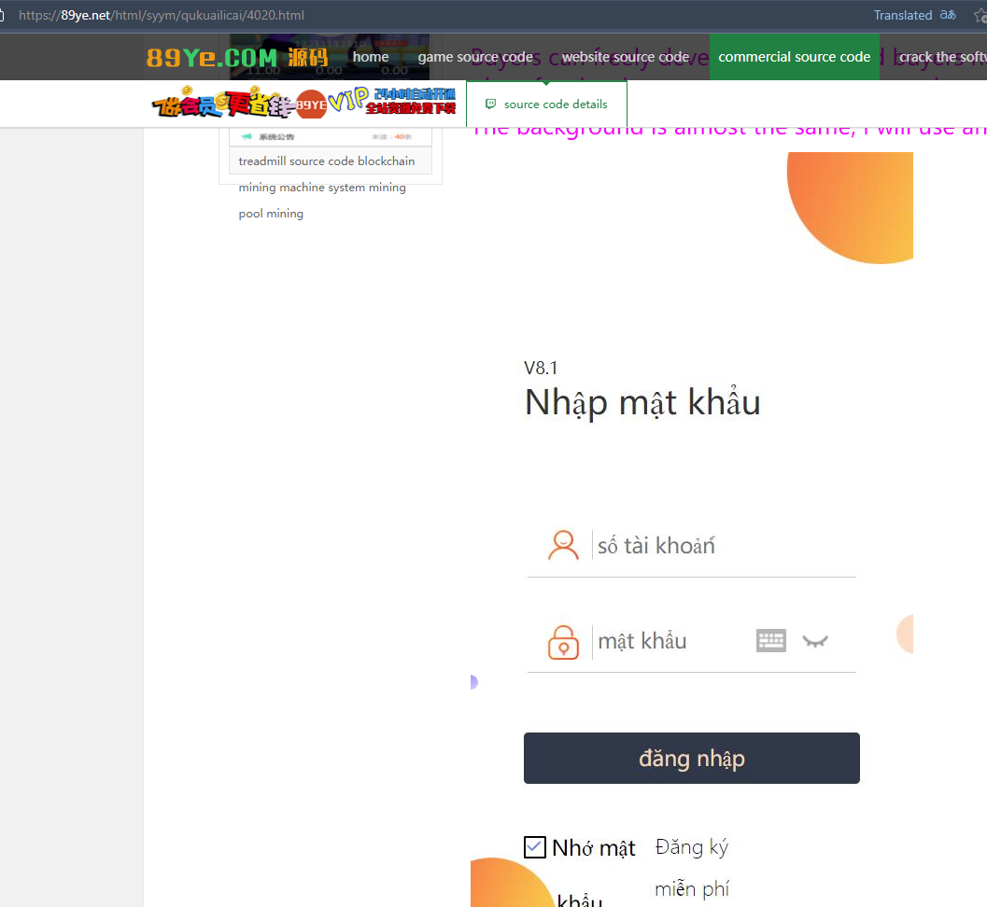
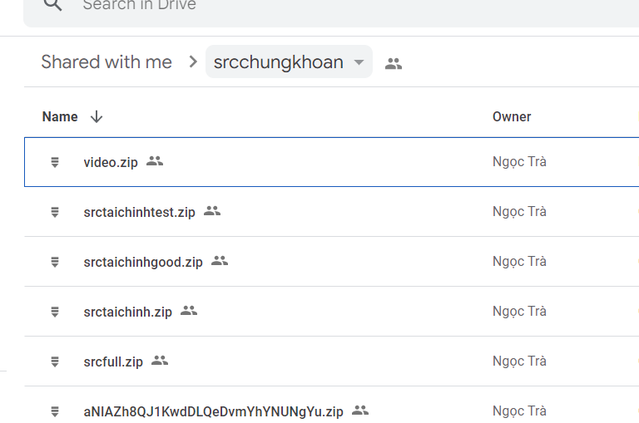
Source code Free and paid “scam” source code anywhere

Slide 8
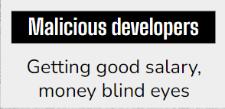
Malicious developers

Slide 9
$30 - $30,000
From To
From low budget to big budget projects
How online Scam becomes a criminal enterprise

Slide 10
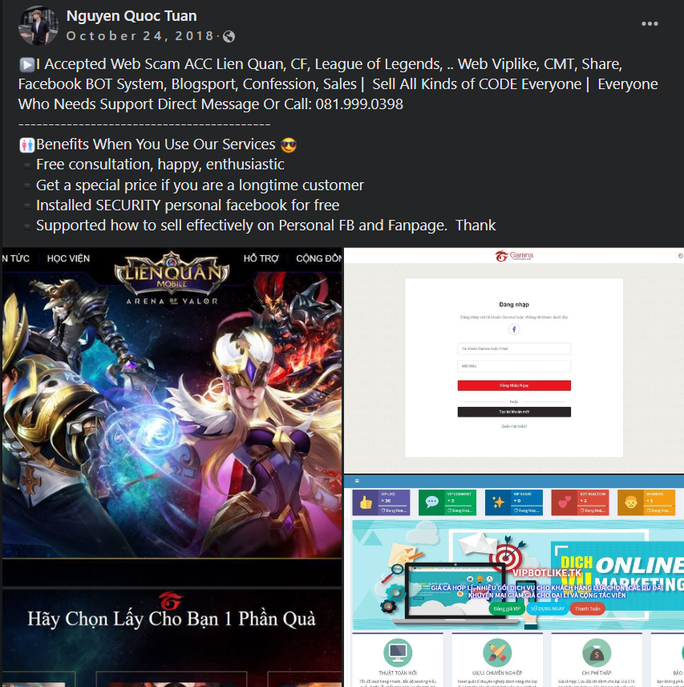
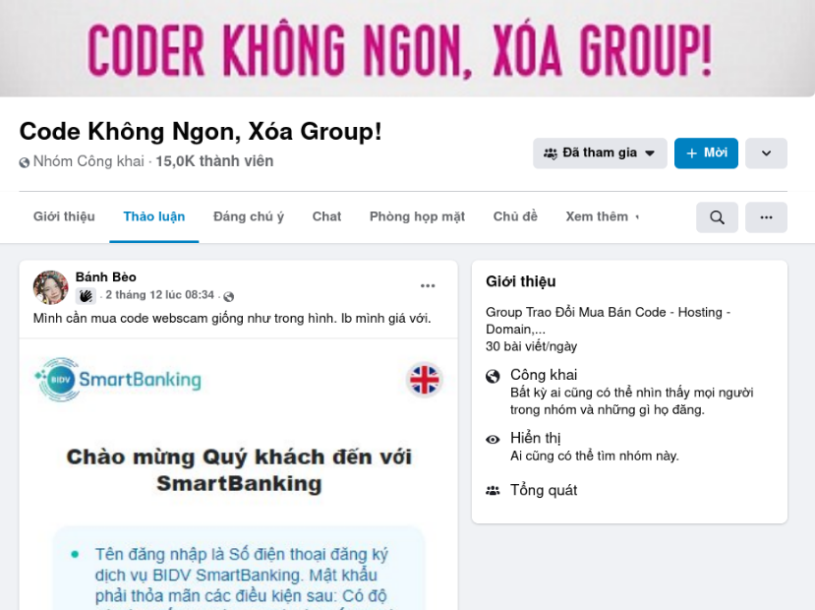
Malicious developers Getting good salary, money blind eyes

Slide 11
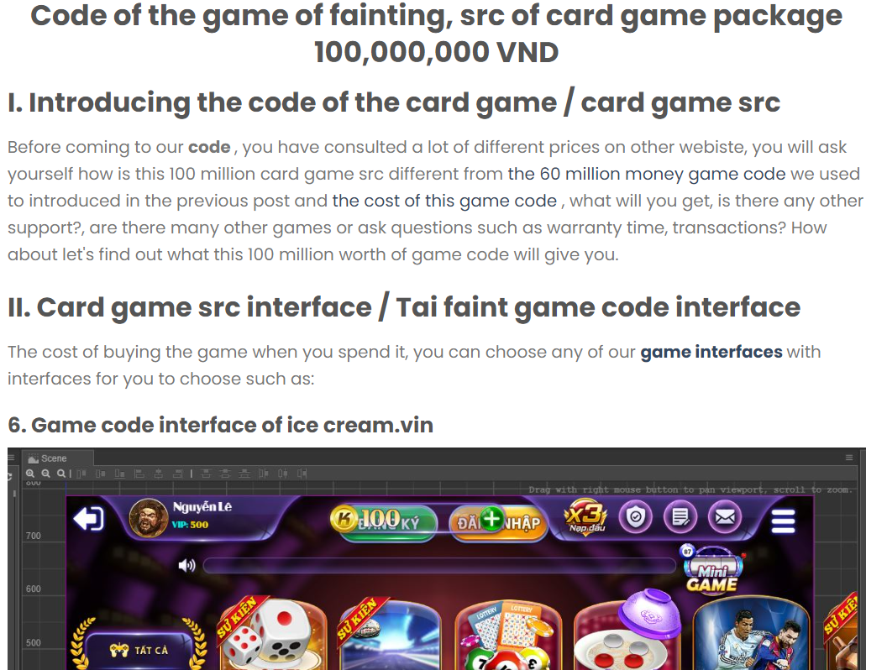
Malicious developers Getting good salary, money blind eyes

Slide 12
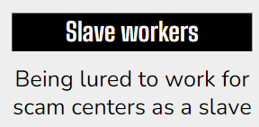
Slave workers
Notes:
The Asia Nikkei quoted an expert as saying that at the peak of 2019, the online gambling and scam centers in Sihanoukville, which generated billions of dollars in annual profits, employed tens of thousands of workers.
In 2022, the Vietnamese and Chinese embassies in Cambodia issued warnings about the threat posed by human trafficking groups, warning that victims are often lured with offers of "high-paying easyjobs".

Slide 13
$700 - $1,500
Salary of Slave worker
From To
How online Scam becomes a criminal enterprise

Slide 14
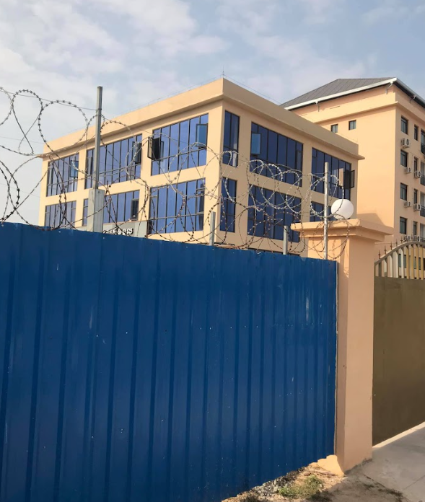
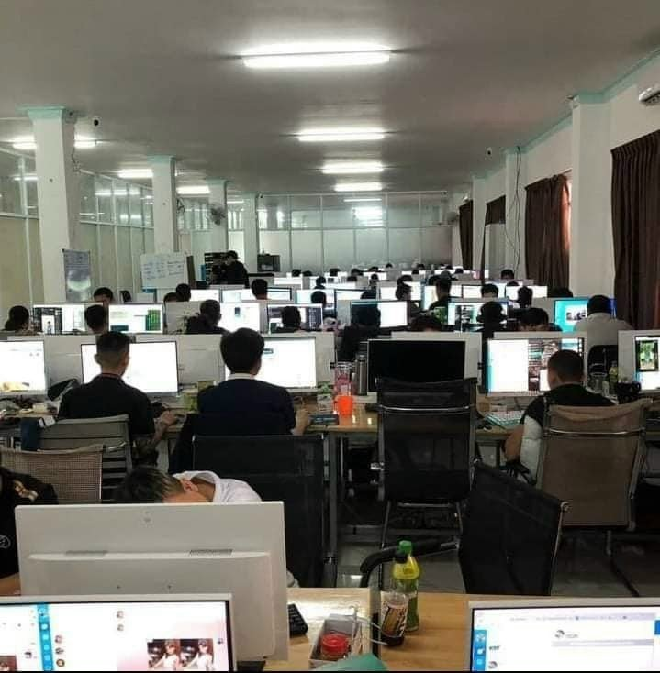
Slave workers Being lured to work for scam centers as a slave

Slide 15
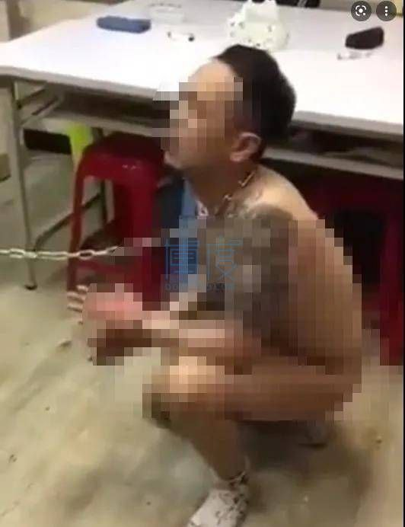
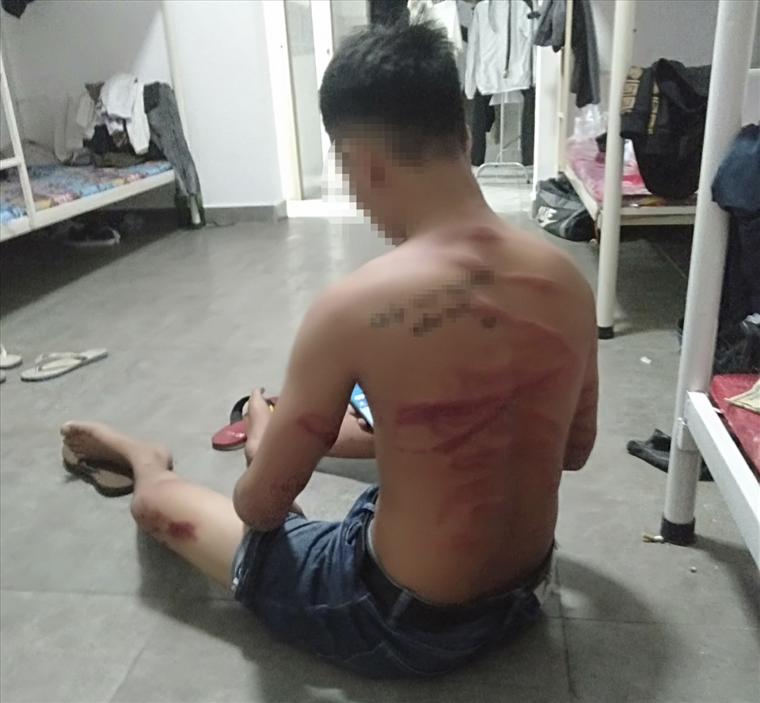
Slave workers Being lured to work for scam centers as a slave
Notes:
Without experience and professional qualifications, with a high salary of 700-1,000 USD/month. After the workers agree, the subjects will contact and organize to bring the victims to Cambodia. When they arrived in Cambodia, these people were taken to scam centers.
Here, they will be trained on how to find, solicit, and entice customers to participate in online investment platforms, online gambling and also impersonate police officers to scam people via phone calls, text messages and so on. Workers are also closely monitored, exploited, forced to work (maybe 15-16 hours/day), otherwise they will be treated badly.

Slide 16
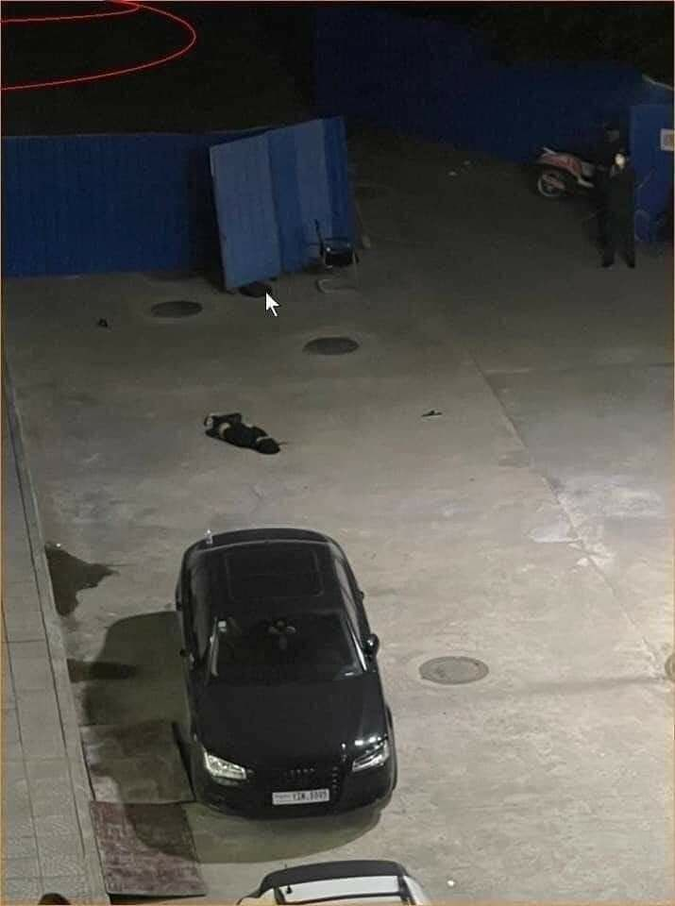
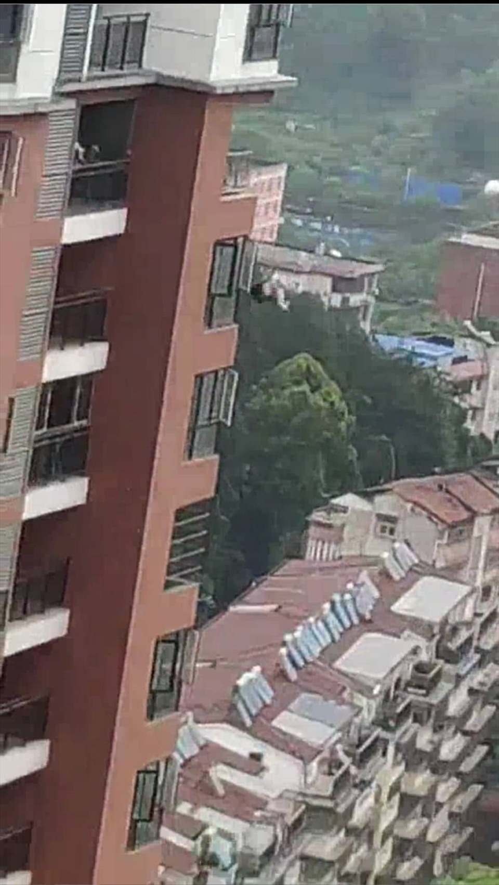
Slave workers Being lured to work for scam centers as a slave
Notes:
Resouces: https://twitter.com/AJ101East/status/1563055823189934080?t=P8214xq-WHqyv__-PhYV2g&s=19 https://tuoitre.vn/lua-dao-viec-nhe-luong-cao-o-campuchia-nan-nhan-tu-nhieu-quoc-gia-vung-lanh-tho-20220823153510811.htm https://dantri.com.vn/lao-dong-viec-lam/bay-viec-nhe-luong-cao-tai-campuchia-deu-do-nguoi-trung-quoc-dao-dien-20220614184909250.htm
https://dantri.com.vn/xa-hoi/8-la-don-keu-cuu-ve-viec-bi-lua-sang-campuchia-lam-viec-nhe-luong-cao-20220617104238373.htm https://tuoitre.vn/lua-dao-viec-nhe-luong-cao-o-campuchia-nan-nhan-tu-nhieu-quoc-gia-vung-lanh-tho-20220823153510811.htm https://vodenglish.news/human-trafficking-committee-vows-action-regardless-of-suspected-links/

Slide 17
$1000 - $15,000
Amount of Ransom Money
From To
How online Scam becomes a criminal enterprise

Slide 18
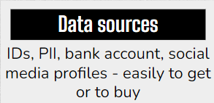
Data sources

Slide 19
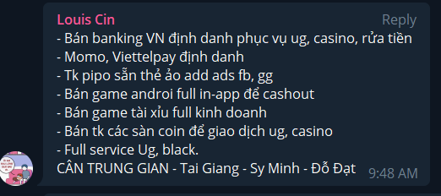
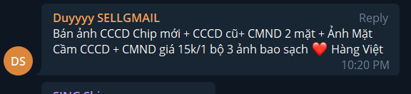
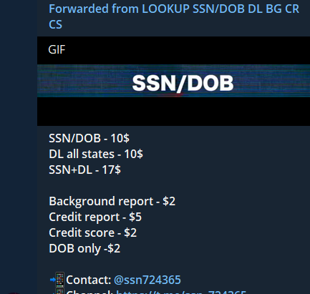
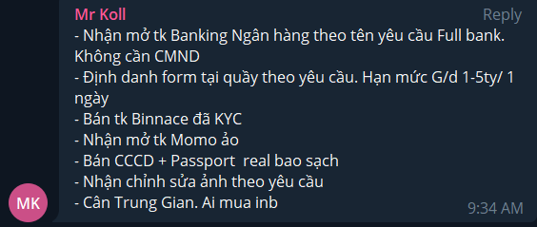
Data sources IDs, PII, bank account, social media profiles - easily to get or to buy

Slide 20
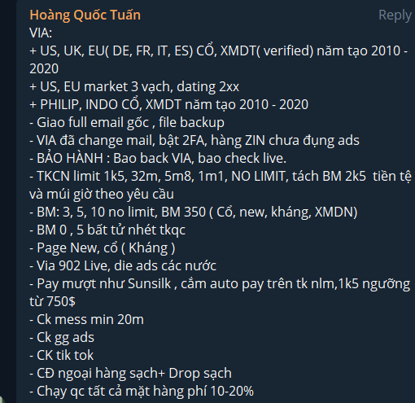

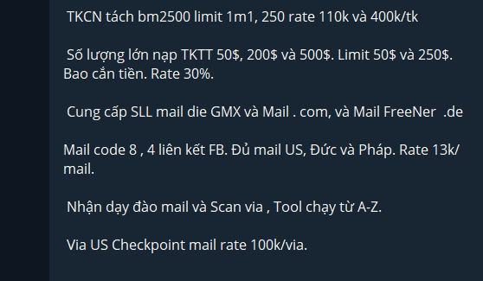
Data sources IDs, PII, bank account, social media profiles - easily to get or to buy

Slide 21

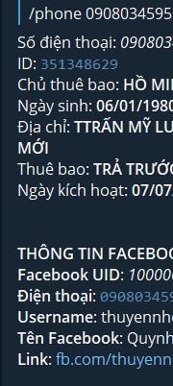
Data sources IDs, PII, bank account, social media profiles - easily to get or to buy

Slide 22
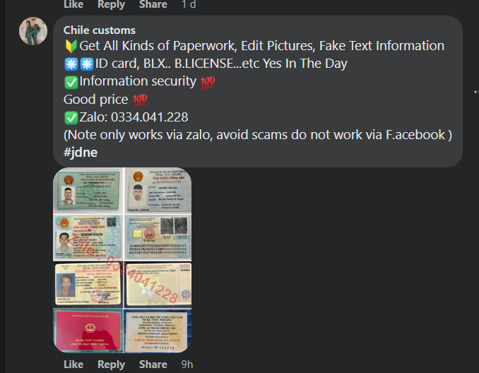
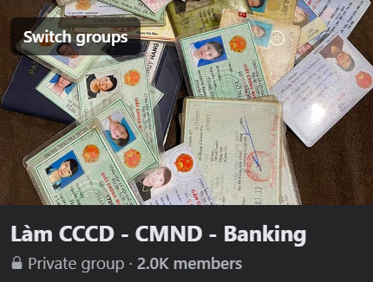
Data sources IDs, PII, bank account, social media profiles - easily to get or to buy

Slide 23
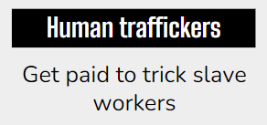
Human traffickers

Slide 24
$200 - $3000
Make Money per Slave worker
From To
How online Scam becomes a criminal enterprise

Slide 25
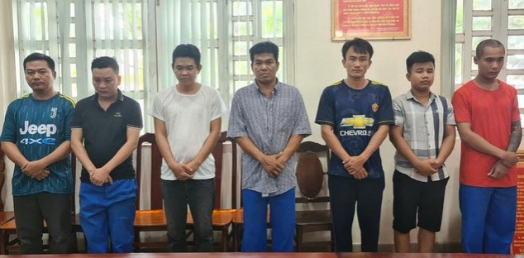
Human traffickers IGet paid to trick slave workers
Notes:
Resources: https://dantri.com.vn/phap-luat/thu-doan-cua-ke-buon-nguoi-va-hanh-trinh-giai-cuu-4-thanh-nien-hai-phong-20220830164328457.htm https://plo.vn/campuchia-truy-quet-nan-buon-nguoi-kiem-tra-toan-bo-nguoi-ngoai-quoc-post694944.html
https://tiengchuong.chinhphu.vn/de-phong-sap-bay-ke-buon-nguoi-113220707183342397.htm

Slide 26
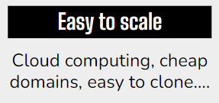
Easy to scale
Notes:
The ease of rapidly switching to new URLs and cheap hosting cost makes services such as Alibaba, AWS, and Azure a viable target for the scammers.

Slide 27
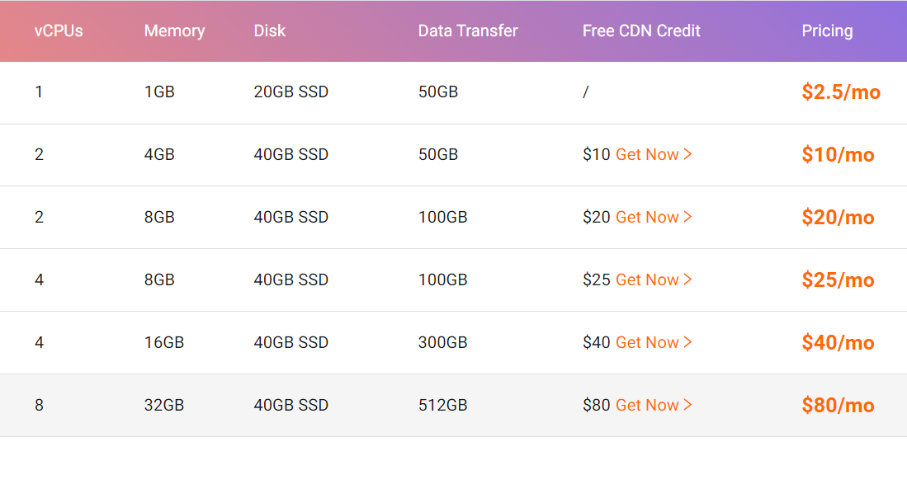

Easy to scale Cloud computing, cheap domains, marketing tools….

Slide 28

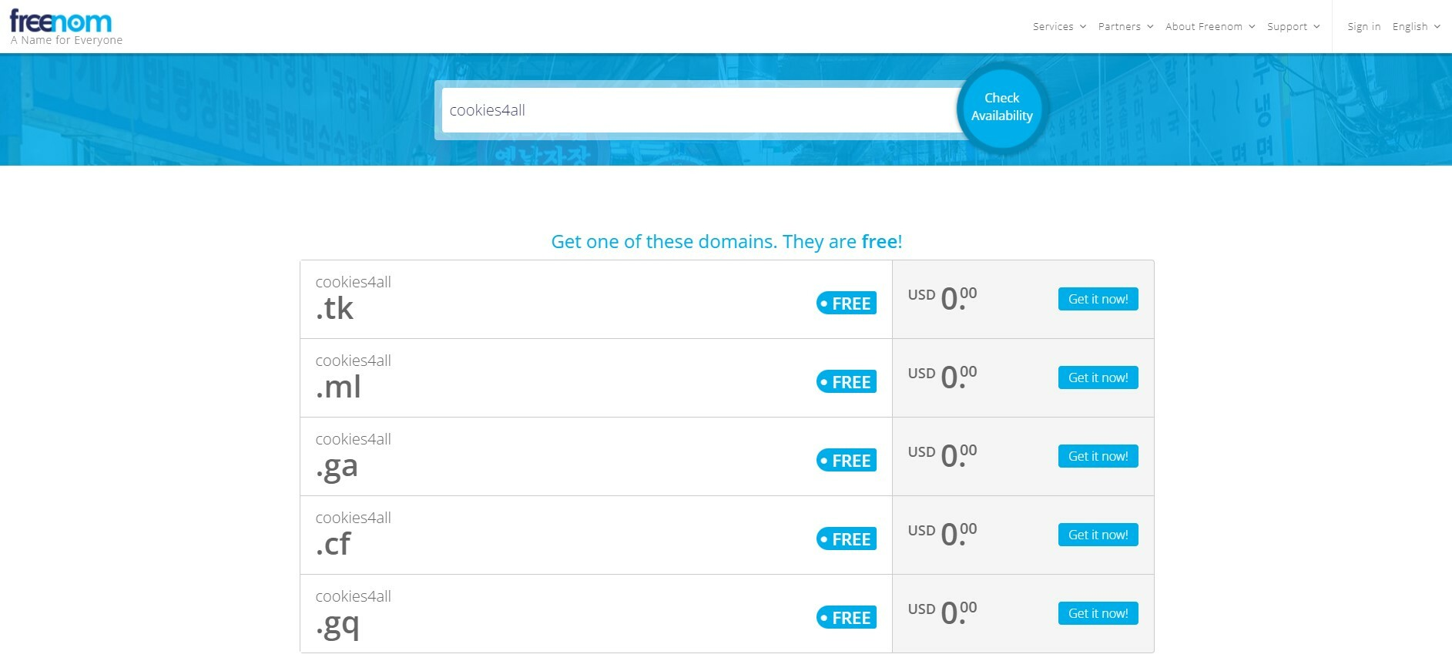
Easy to scale Cloud computing, cheap domains, marketing tools…..

Slide 29
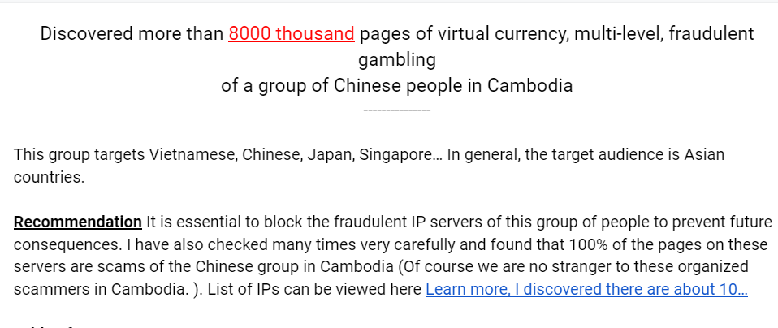
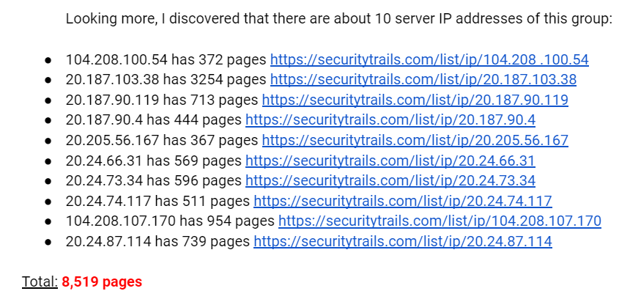
Easy to scale Cloud computing, cheap domains, marketing tools….
Notes:
The interface is sketchy, the images are poor quality, and the interface is the same, only the logo is different for each different floor (maybe each floor is different to target scams in different countries, for easy management purposes)
There are comments in the source code in Chinese
Often domain names ending in .top, .xyz, .co, .cn, .com, .vip, .cc, .info
The content on the website is often sketchy, misspelled, and missing. Obviously
Pay with virtual currency
There is a mobile app for your phone, but you have to download the .ipa file (for iOS) or .apk (for Android), there is no app on CHPlay or Apple Store
There are points like there is usually a subdomain or path when entering the login section: h5
Using Vue.js or ThinkPHP is the main
one Poor security or leaving the default password 123456 for the admin account
Using the same AWS S3 Bucket for KYC data.

Slide 30
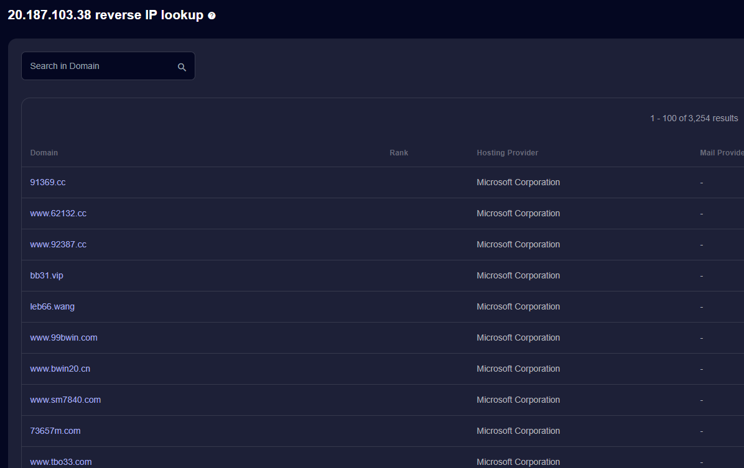
Easy to scale Cloud computing, cheap domains, marketing tools…..

Slide 31


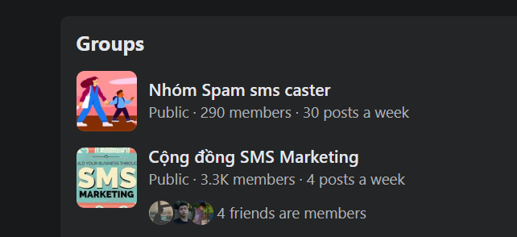
Easy to scale Cloud computing, cheap domains, marketing tools….
Notes:
Renting marketing tools to get more victims

Slide 32
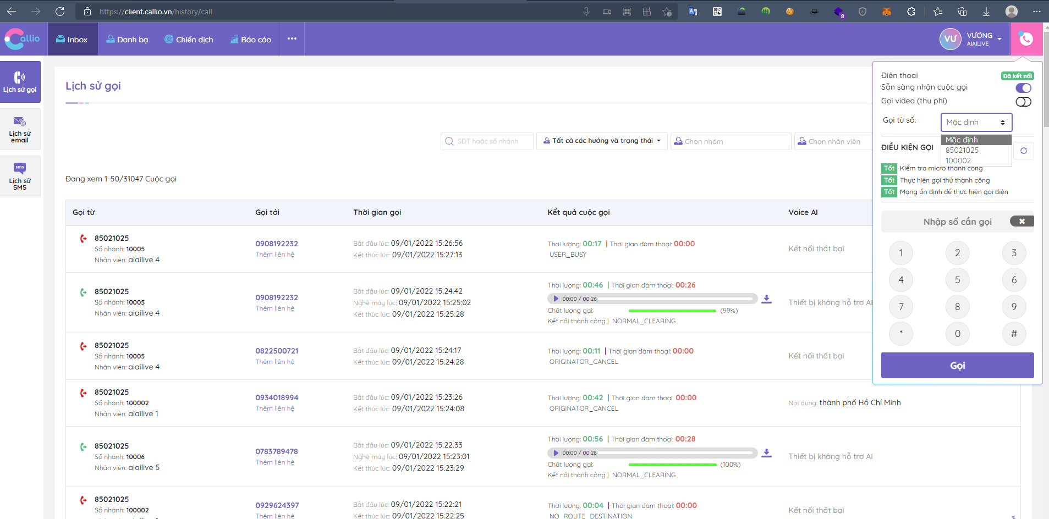
Easy to scale Cloud computing, cheap domains, marketing tools….
Notes:
Using Telemarketing to mass introduce their scam websites.

Slide 33
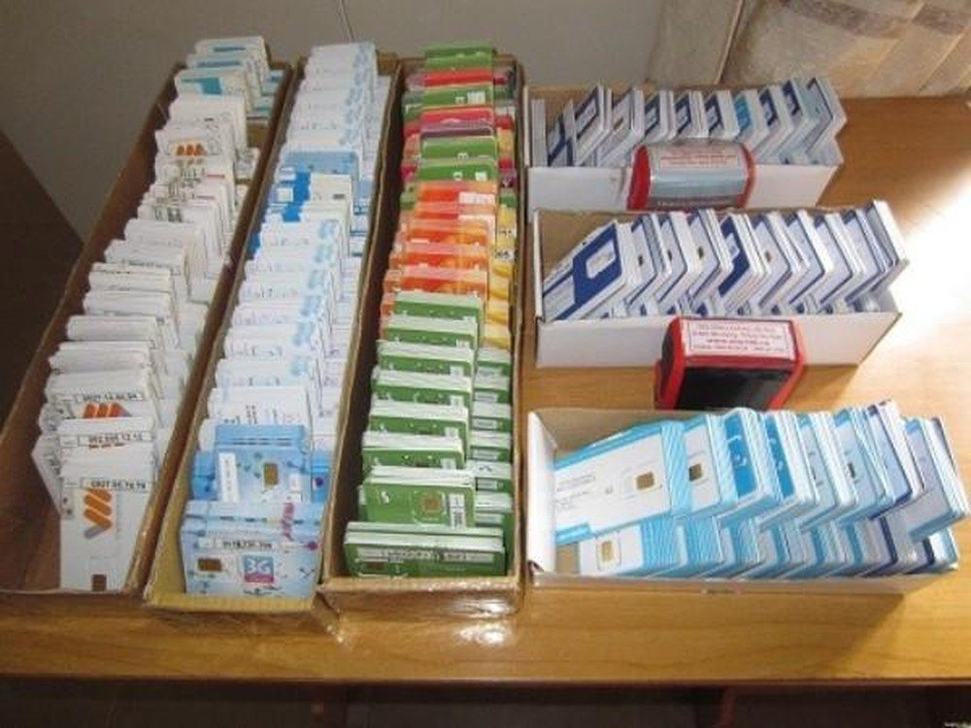
Easy to scale Cloud computing, cheap domains, marketing tools….

Slide 34
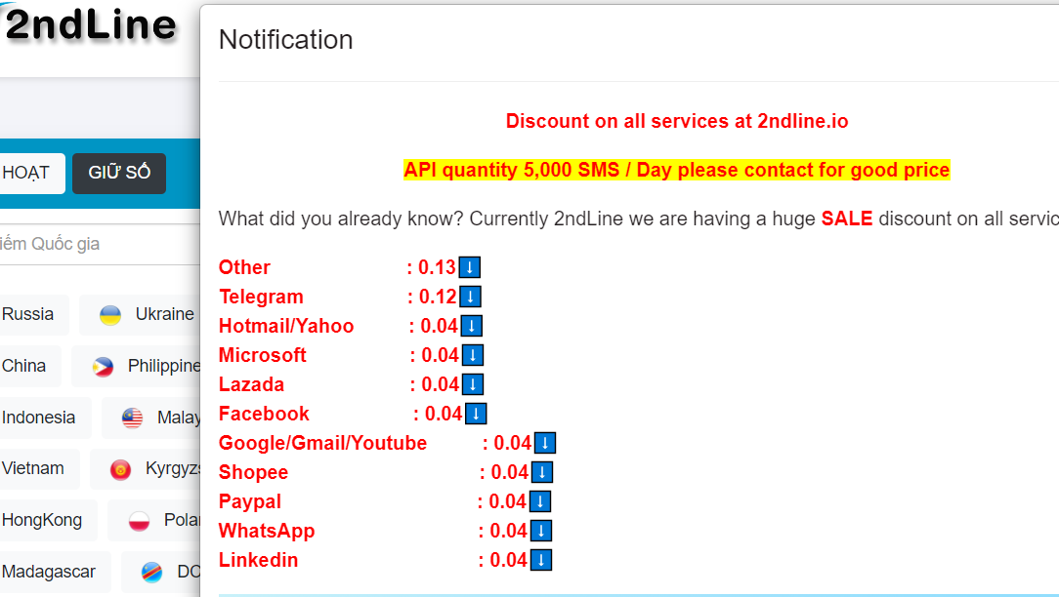
Easy to scale Cloud computing, cheap domains, marketing tools….

Slide 35

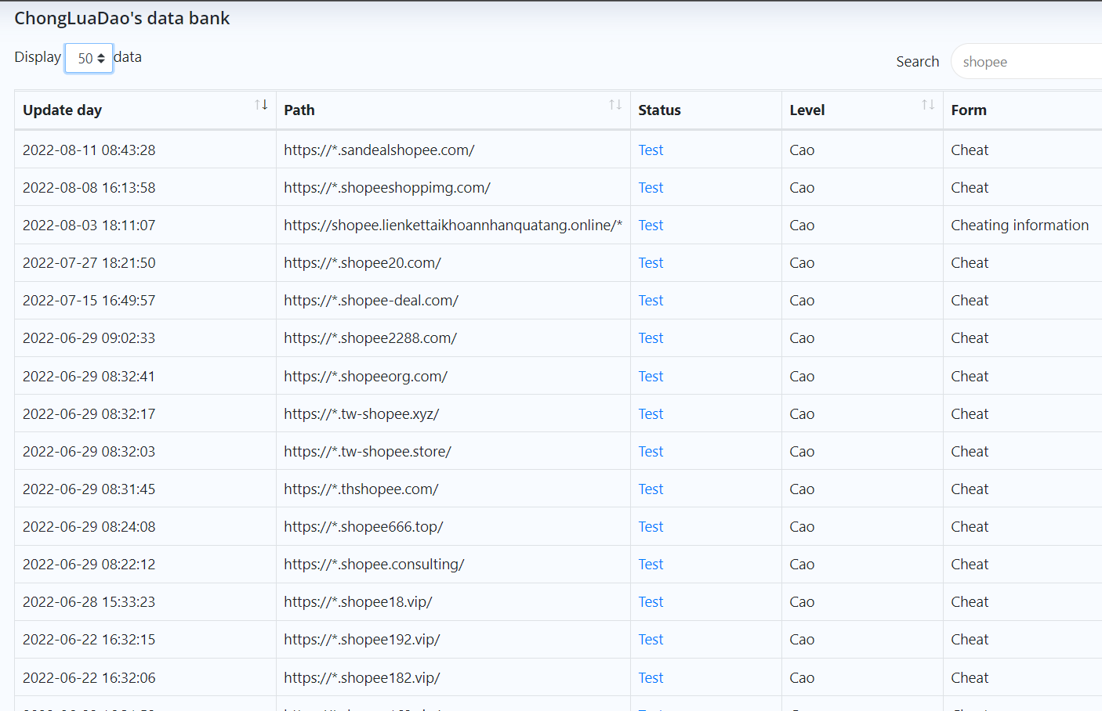
Easy to scale Cloud computing, cheap domains, marketing tools….
Notes:
Using social media to advertise about their scam websites. Resource: https://chongluadao.vn/thong-ke

Slide 36
THANK YOU!
Do you have any questions?
info@chongluadao.vn
Hieu Ngo Linkedin: linkedin.com/in/hieu-minh-ngo-hieupc
How online Scam becomes a criminal enterprise Hieu Minh Ngo - NCSC Viet Nam (ncsc.gov.vn) - Co-founder: ChongLuaDao.vn

